Slide 1
SDN Oriented DDoS Detection and Mitigation for Bot-based attacks
By
Salim Ali Siddiq
Graduate Student – Telecommunication Systems Management
Northeastern University, Boston, MA
25th April, 2017

Slide 2
Introduction & motivation
Software-Defined Networking (SDN) is an emerging paradigm that promises to change this state of affairs by separating the network’s control plane from the data plane, thereby promoting (logical) centralization of network control and introducing the ability to program the network.
Internet, in general, is vulnerable to various kinds of attacks like DDoS, DoS, dictionary attacks etc. DDoS attacks mounted by botnets has been termed as biggest threat to internet security today.
In this project, I have implemented a DDoS attack detection and mitigation application in an SDN environment.

Slide 3
Conventional routers are so difficult to modify their behavior.
SDN architecture based on OpenFlow specification makes it much easier to dynamically modify the behavior of network switches.
Moreover, in the traditional Internet architecture, routers perform routing and control in a distributed manner. It is hard to elicit an orchestrated network-wide behavior.
However, in SDN, the existence of a central controller makes the task so much easier.

Slide 4
Ddos explained
DDoS attacks today typically target specific services so that only the targeted application is disabled while other network components (e.g. links, switches, routers) are not affected much
Such a targeted attack can easily hide itself in normal traffic due to low required attack intensity
Modern DDoS attacks exploit a potentially large number of bots, or compromised hosts. Since these otherwise innocent hosts issue legitimate looking service requests to the attacked server, the attack traffic looks like normal traffic

Slide 5

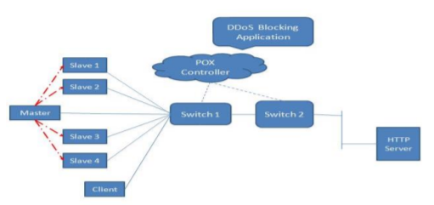
ARCHITECTURE
We will be having a small network setup on the virtual machine, with mininet installed.
This network will contains 1 POX controller, 2 switches, 6 hosts and 1 HTTP server.
The DDoS detection and blocking application will be started on the POX controller

Slide 6
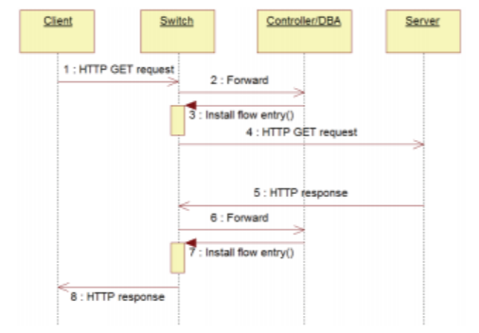
workflow
When a new request from a client arrives at an OpenFlow switch, it does not match any existing flow.
It is reported to the controller, which directs the switch to create a flow table entry for the new packet.
When the server responds to the request from the client, another flow entry is created at the switch, but in the reverse direction
Using the new flow reports, the controller monitors the total number of flows at each flow switch.
Also, the server monitors metrics such as number of requests per interval and number of requests in last interval to indicate a possible DDoS attack.

Slide 7
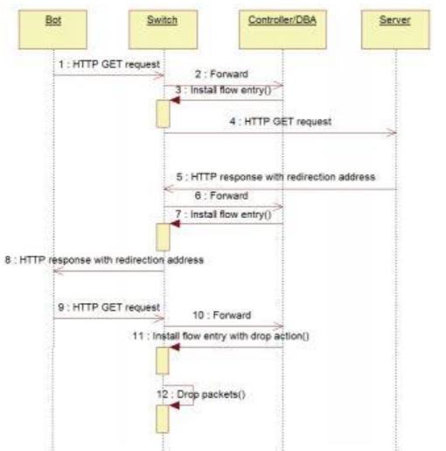
Ddos detection & Mitigation workflow
When the controller determines that a DDoS attack has occurred and the server collapse is imminent, it starts putting the sources whose requests per interval exceed the nominal amount and ultimately dropping all the packets that are destined to the server.
Any host address that is present in the blacklist maintained by the DBA is not able to get through to the server.
When a client is classified as a bot, a flow entry with “drop” as the associated action is installed.

Slide 8
Approaches
USE OF HONEYTOKENS
Honeytokens are used as a means to lure malicious users.
The web server has two files, a legitimate file and a honeytoken file.
The server maintains its own blacklist to track the IP of those users that try to access the honeytoken.
Any interaction with a honeytoken most likely represents unauthorized or malicious activity.
USE OF CAPTCHA
Once the server detects an attack, the server goes in the CAPTCHA mode
Any subsequent requests it asks users to authenticate themselves by entering the CAPTCHA.
This way the legitimate and illegitimate users are differentiated.

Slide 9
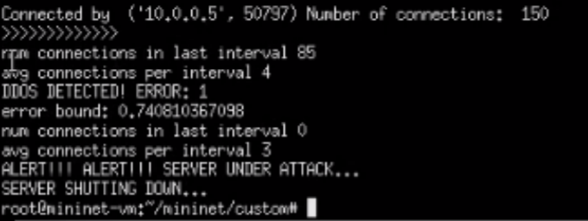
Ddos detection
Server detects the DDoS attack and shuts down

Slide 10
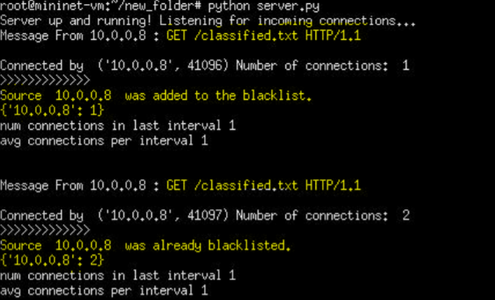
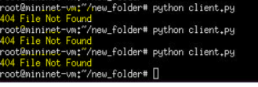
Honeytoken file accessed
The IP is blacklisted when a particular IP accesses the honeytoken file
Hence, host isn’t able to access the file after that

Slide 11

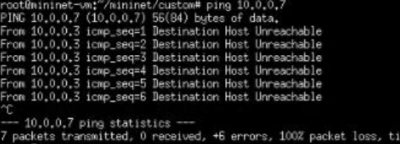
Pox controller terminal
The blocking application in the POX controller detects the DDoS attack and blocks it
Hence, the connection failed message
Ping isn’t possible to the server after that

Slide 12
Future work
CAPTCHA breakers have become advanced. More complex CAPTCHA such as image CAPTCHA along with the normal CAPTCH can be used in future
This project was for bot-based attacks. This can be tweaked and developed for any DDoS attacks
Can be implemented in advanced versions of open flow. This was done for open flow v1.3

Slide 13
conclusion
The scheme does not require much communication between the DDoS blocking application running on the SDN controller and the server to be protected.
Controlled access to the important data is ensured using CAPTCHA.
Furthermore, honeytokens are used as a mechanism for early detection and confirmation of threats.

Slide 14
references
Lim, S.; Ha, J.; Kim, H.; Kim, Y.; Yang, S., "A SDN-oriented DDoS blocking scheme for botnetbased attacks," Ubiquitous and Future Networks(ICUFN), 2014 Sixth International Conf on , vol.,no., pp.63,68, 8-11 July 2014.
S. Shin et al., “FRESCO: Modular Composable Security Services for Software-Defined Networks,” Proc. ISOC NDSS, 2013.
Open Networking Foundation, OpenFlow Switch Specification v.1.4.0, Oct. 2013.
Kreutz, D.; Ramos, F.M.V.; Esteves Verissimo, P.; Esteve Rothenberg, C.; Azodolmolky, S.; Uhlig, S., "Software-Defined Networking: A Comprehensive Survey," Proceedings of the IEEE , vol.103, no.1, pp.14,76, Jan. 2015
Spitzner, L., "Honeypots: catching the insider threat," Computer Security Applications Conference,2003. Proceedings. 19th Annu

Slide 15
Thank you

